Slide 1


測量結果
MEASURING
OUTCOME

Slide 2

如何引導遊戲
這遊戲基於 Evidence Based Management (EBM). EBM 是組織可以用來幫助測量 (感知到的) 產品價值以及產品交付方式的經驗框架。檢視這這些度量可以幫助最大化產品價值並改善工作的方式。
Scrum Facilitators 是一家位於荷蘭的培訓機構，其使命是幫助專業人士成為出色的 Scrum facilitators. Scrum Facilitator 可以是 Scrum Master，產品負責人 (Product Owner)，開發人員(Developers) 或是領導人 （leader）。 偉大的 Scrum Facilitators 了解 Scrum 的價值觀和原則，並利用這些價值觀和原則與他們的團隊和組織一起有效的實施 Scrum。
Scrum Facilitators 是 Scrum.org 的夥伴。我們的課程經過認證，始終保持最新，有趣，超級互動，並始終由兩名培訓師提供幫助，以最大限度地提高您的學習目標。 我們的培訓師是經驗豐富的專家，是經過 Scrum.org 認證的專業 Scrum 培訓師，在各種環境中都具有豐富的現實生活經驗。
身為一個 Scrum Facilitator 的角色，把四個關鍵價值領域 (Key Value Areas, KVAs) 在地上放成一橫排 (Current Value, Time to Market, Ability to Innovate 與 Unrealized Value)，並為參與者解釋各個關鍵價值領域 (KVA)。
分成兩組，一組拿綠色的關鍵價值度量 (Key Value Measures, KVMs) 卡片，另一組拿紫色的 KVMs 卡片。
步驟一：邀請各小組討論拿到的關鍵價值度量 (KVM) 卡片 看應該屬於哪一個關鍵價值領域 (KVA)。
步驟二：邀請小組一起討論結果並調適卡片。請確保在此回合結束時，關鍵價值度量 (KVM) 卡片有對應到正確的關鍵價值領域 (KVA)。
步驟三：邀請參與者個資查看關鍵價值度量 (KVM) ，並選擇一個引起他們注意的 (KVM)。 (此時也可以選擇非EBM KVM)
步驟四：邀請參與者分成四組。讓每個參與者解釋為什麼他們選擇自己的特定KVM並就如何實施它進行協作。 （對於非 EBM 的度量，請注意這些度量不是虛榮指標，並討論潛在的陷阱）
Learn about Evidence-Based Management (EBM) at http://scrum.org/EBM
The Measuring Outcome game (v1.0.2) is licensed under
CC BY-NC-SA 4.0
By Scrum Facilitators 繁體中文翻譯： Tony Lee

Slide 3
Reveals the value that the product delivers to customers, today
目前價值
展示出產品在今日可提供給客戶的價值
CURRENT VALUE
Reveals the value that the product delivers to customers, today

Slide 5
回應市場時間
表達組織快速傳遞新功能、服務或產品的能力
TIME TO MARKET
Expresses the organization’s ability to
quickly deliver new capabilities, services, or products

Slide 7
創新能力
展現組織提供可能更好地滿足客戶需求的新功能的有效性。
ABILITY TO
INNOVATE
Expresses the ability of a product development organization to
deliver new capabilities that might better meet customer needs

Slide 9
未實現價值
當組織滿足所有潛在客戶或使用者的需求時可以實現的潛在未來價值
UNREALIZED VALUE
Suggests the potential future value that could be realized
if the organization could perfectly meet the needs of all potential customers

Slide 11
員工平均營收
該比率（總收入/雇員人數）是一個行業中的關鍵競爭指標。
這因行業而異。
Revenue per Employee
The ratio (gross revenue / # of employees) is a key competitive indicator within an industry. This varies significantly by industry.

Slide 13
產品成本率
測量產品/系統的總費用和成本，包括運營成本與收入的比較。
Product Cost Ratio
Total expenses and costs for
the product(s)/system(s) being measured,
including operational costs compared to revenue.

Slide 15
員工滿意度
某種形式的情緒分析有助於測量員工的敬業度、活力和熱情。
Employee Satisfaction
Some form of sentiment analysis to help
gauge employee engagement, energy, and enthusiasm.

Slide 17
顧客滿意度
某種形式的情感分析幫助評估客戶對產品的參與度和滿意度。
Customer Satisfaction
Some form of sentiment analysis to help
gauge customer engagement and happiness with the product.

Slide 19
客戶使用率指數
按功能對使用方式進行測量，
以説明推斷客戶發現該產品實用的程度，
以及使用時間是否符合期望。
Customer Usage Index
Measurement of usage, by feature, to help infer
the degree to which customers find the product useful and whether actual usage meets expectations on
how long users should be taking with a feature.

Slide 21
市場份額
產品不受控制的相對市場百分比；
如果產品能夠更好地滿足客戶需求，
那麼它可能會獲得潛在的市場份額。
Market Share
The relative percentage of the market
not controlled by the product;
the potential market share that the product
might achieve if it better met customer needs.

Slide 23
客戶或用戶滿意度差距
客戶或使用者期望的體驗與他們當前的體驗之間的區別。
Customer or User Satisfaction Gap
The difference between a customer or user’s
desired experience and their current experience.

Slide 25
客戶體驗或滿意度期望
表示客戶希望獲得的體驗的測量。
Desired Customer
Experience or satisfaction
A measure that indicates
the experience that the customer would like to have

Slide 27
建置和整合頻率
每個時間段內經過整合和測試的內部版本數。
對於頻繁或連續發佈的團隊，
此度量已被實際的發佈度量所取代。
Build and Integration Frequency
The number of integrated and tested builds per time period.
For a team that is releasing frequently or continuously,
this measure is superseded by actual release measures.

Slide 29
發佈頻率
每個時間段的發佈次數，例如 連續、每天、每周、每月、每季度等。這有助於反映出用新穎及有競爭力的產品來滿足客戶需求的時間。
Release Frequency
The number of releases per time period,
e.g. continuously, daily, weekly, monthly, quarterly, etc.
This helps reflect the time needed to satisfy the customer
with new and competitive products.

Slide 31
發佈穩定期
在開發人員準備發佈產品到實際發佈給客戶之間，
花費在糾正產品問題上的時間。
這有助於表示不良的開發實踐以及基礎設計和代碼庫的影響。
Release Stabilization Period
The time spent correcting product problems between the point the developers say it is ready to release and the point where it is actually released to customers. This helps represent the impact of poor development practices and underlying design and code base.

Slide 33
平均維修時間
從發現錯誤到修復錯誤所花費的平均時間。
這有助於揭示組織修復錯誤的效率。
Mean Time to Repair
The average amount of time
it takes from when an error is detected and when it is fixed.
This helps reveal the efficiency of an organization to fix an error.

Slide 35
客戶週期時間
從開始工作到實際發佈為止間的時間。
這有助於反映組織接觸客戶的能力。
Customer Cycle Time
The amount of time from when work starts on a release until the point where it is actually released. This measure helps reflect an organization’s ability to reach its customer.

Slide 37
交付時間
從提出想法或建立假設到客戶從該想法中受益的時間。
此測量可能會根據客戶和產品而有所不同。
這是提高客戶滿意度的重要因素。
Lead Time
The amount of time from when an idea is proposed, or a hypothesis is formed until a customer can benefit from that idea. This measure may vary based on customer and product. It is a contributing factor for customer satisfaction.

Slide 39
變更交付時間
從提交代碼到成功在生產中運行代碼所需的時間。
Lead Time for Changes
The amount of time to go from code-committed to code successfully running in production.

Slide 41
部署頻率
組織向客戶/使用者部署（發佈）該產品的新版本的次數。
Deployment Frequency
The number of times that the organization deployed (released)
a new version of the product to customers/users.

Slide 43
服務恢復時間
從服務中斷開始到恢復服務的完全可用性之間的時間。
Time to Restore Service
The amount of time between the start of a service outage and the restoration of full availability of the service.

Slide 45
學習時間
草擬一個想法或改善、構建、
將其交付給使用者並從其使用中學習所需的總時間。
Time-to-Learn
The total time needed to sketch an idea or improvement, build it, deliver it to users, and learn from their usage.

Slide 47
清除障礙的時間
從產生障礙到解決障礙間的平均時間。
這是交付時間和員工滿意度的一個促成因素。
Time to remove Impediment
The average amount of time
from when an impediment is raised until when it is resolved.
It is a contributing factor to lead time and employee satisfaction.

Slide 49
戰略轉向的時間
真實業務敏捷性的一種測量，表示組織從收到反饋或新資訊到響應該反饋之間所經過的時長；例如，從發現競爭對手提供了新的市場制勝功能到組織以匹配或超越其新功能的方式做出回應（可測量地改善客戶體驗）之間的時間。
Time to Pivot
A measure of true business agility that presents the elapsed time between when an organization receives feedback or new information and when it responds to that feedback; for example, the time between when it finds out that a competitor has delivered a new market-winning feature to when the organization responds with matching or exceeding new capabilities that measurably improve customer experience.

Slide 51
創新率
在新產品功能上花費的工作量或成本的百分比除以產品總工作量或成本。這可以得到組織提供新產品功能的能力。
Innovation Rate
The percentage of effort or cost spent on new product capabilities, divided by total product effort or cost.
This provides insight into the capacity of the organization to deliver new product capabilities.

Slide 53
缺陷趨勢
自上次測量以來，對缺陷變化進行的測量。
缺陷是指降低產品對客戶、使用者或組織本身的價值的所有因素。
缺陷通常是指無法正常運作。
Defect Trends
Measurement of change in defects since last measurement.
A defect is anything that reduces the value of the product to a customer, user, or to the organization itself.
Defects are generally things that don’t work as intended.

Slide 55
產品指數
團隊花費在產品和價值上的時間百分比。
On-Product Index
The percentage of time teams spend
working on product and value.

Slide 57
安裝版本指數
當前受支援的產品版本號。
這反映了組織為支援和維護舊版本軟體而付出的努力。
Installed Version Index
The number of versions of a product that are currently being supported. This reflects the effort the organization spends supporting and maintaining older versions of software.

Slide 59
技術債
程式設計中的一個概念，該概念反映了"快速而骯髒"的解決方案導致後來的補救度量產生的額外開發及測試工作。
它對價值的交付產生不良影響，並造成了可避免的浪費及風險增加。
Technical Debt
A concept in programming that reflects the extra development and testing work that arises when “quick and dirty” solutions result in later remediation. It creates an undesirable impact on the delivery of value and an avoidable increase in waste and risk.

Slide 61
生產事故次數
在一個時期內開發團隊為解決已安裝產品中的問題而被阻斷的次數。
生產事故的次數和頻率有助於表明產品的穩定性。
Production Incident Count
The number of times in a given period that the Development Team was interrupted to fix a problem in an installed product. The number and frequency of Production Incidents can help indicate the stability of the product.

Slide 63
活躍產品（代碼）分支
產品或服務的不同版本（或變體）的數量。
提供對改變的潛在影響以及由此產生的工作複雜性的見解。
Active Product (Code) Branches
The number of different versions (or variants) of
a product or service.
Provides insight into the potential impact of change and the resulting complexity of work.

Slide 65
分支之間花費的時間合併代碼
更改產品或服務的不同版本所花費的時間。
提供對改變的潛在影響以及由此產生的工作複雜性的見解。
Time Spent Merging Code Between Branches
The amount of time spent applying changes across different versions of a product or service. Provides insight into the potential impact of change and the resulting complexity of work.

Slide 67
內容切換花費的時間
實體包括因會議或電話造成中斷而浪費的時間，
在工作之間進行切換所花費的時間，
以及團隊成員受到團隊外部人員的阻擾。
Time Spent Context-Switching
Examples include time lost to interruptions caused by meetings or calls, time spent switching between tasks, and time lost when team members are interrupted to help people outside the team can give simple insight into the magnitude of the problem.

Slide 69
失敗率
已發佈的產品更改導致服務品質下降並需要修復
（例如，緊急修復、 回溯、補丁）的百分比。
Change Failure Rate
The percentage of released product changes that result in degraded service and require remediation
(e.g. hotfix, rollback, patch).

Slide 71
不要測量產出
測量結果
Don’t measure Output. Measure Outcomes

Slide 73
這不是關於指標， 而是關於溝通
It’s not about the Metrics, but about the Conversation

Slide 75
想要了解更多
Evidence Based Management
請見
http://scrum.org/EBM

Slide 77
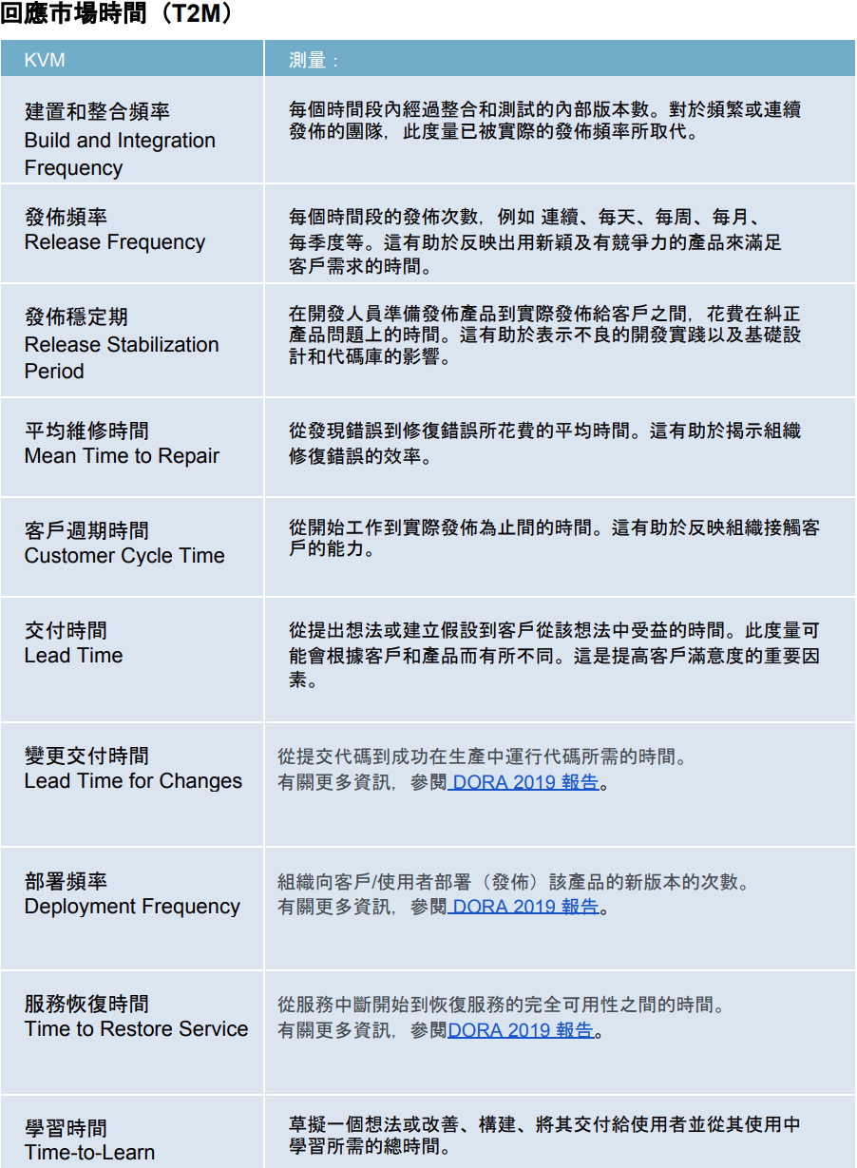
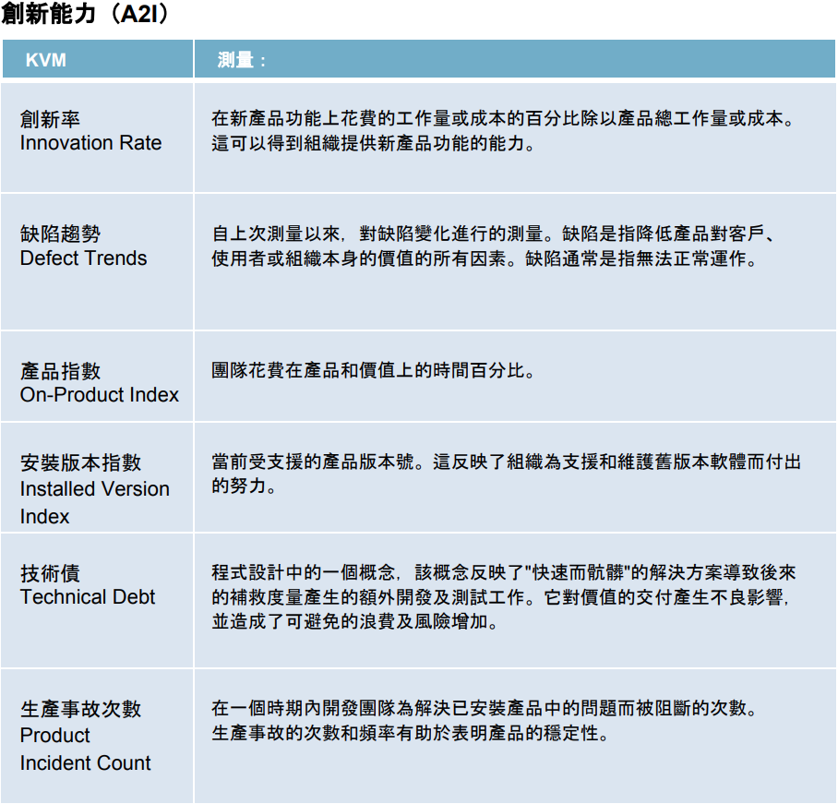
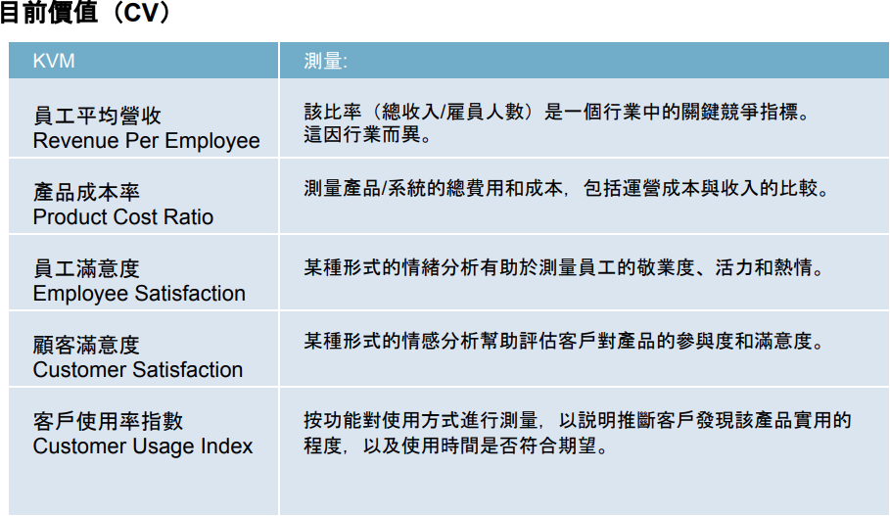
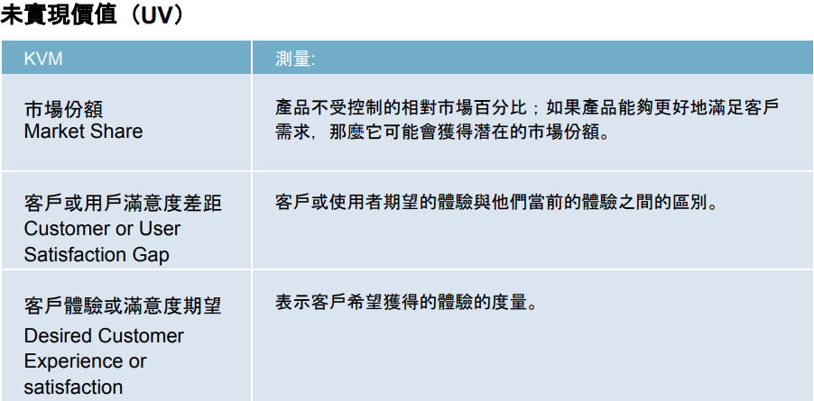
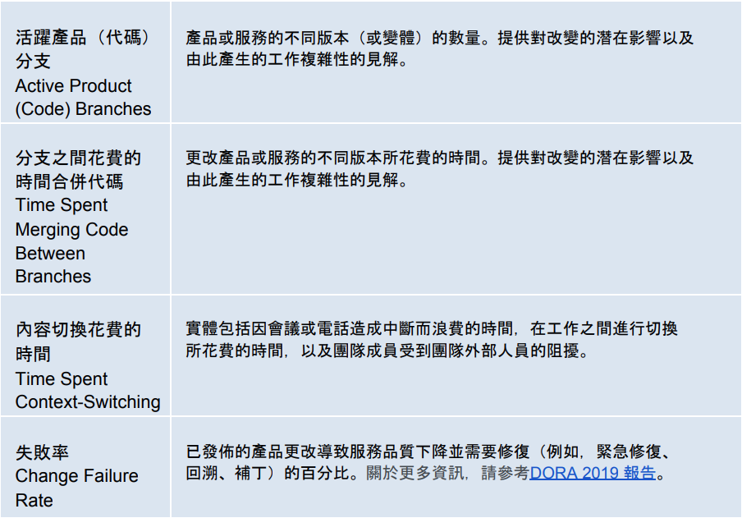
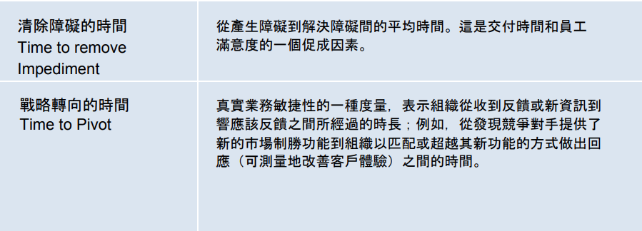
EBM 建議的備忘單
Source: EBM guide, http://scrum.org/EBM

